Slide 1
Topic: Management- Introduction
Dr. C. Vijaya Banu
Professor , School of Management
SASTRA Deemed University, Thanjavur – 613 401
vijayabanu@mba.sastra.edu

Slide 2
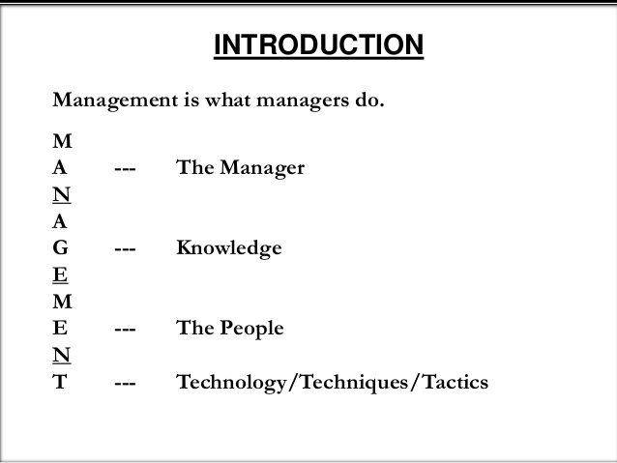

Slide 3
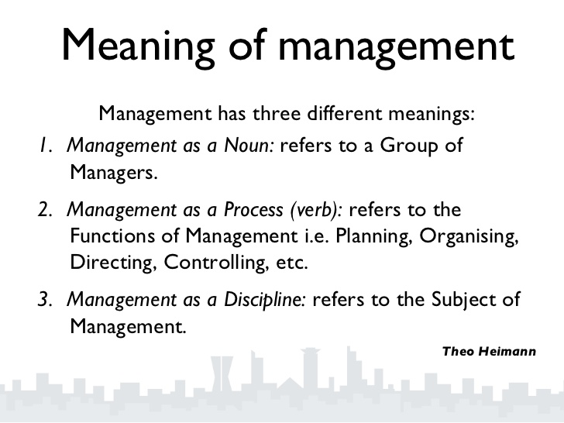

Slide 4
MANAGEMENT
Management is the attainment of organizational goals in an effective and efficient manner through planning, organizing, staffing, directing and controlling organizational resources.
Organizational resources include men(human beings), money, machines and materials.
Management is an important element in every organization. It is the element that coordinates currents organizational activities and plans for the future
The management adapts the organization to its environment and shapes the organization to make it more suitable to the organization

Slide 5
Definitions
Louis E Boone & David L Kurtz- The use of people and other resources to accomplish objectives.
Mary Parker Follet- the art/act of getting things done through people.
Frederick Taylor defines Management as the art of knowing what you want to do in the best and cheapest way.

Slide 6
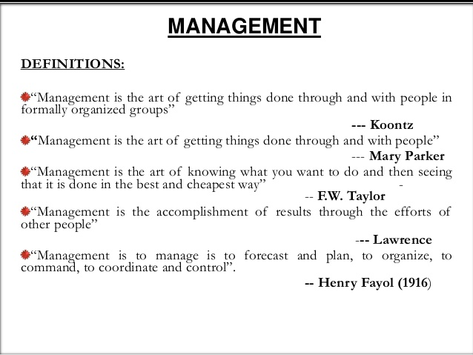

Slide 7
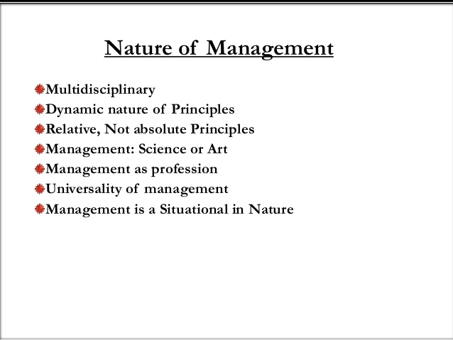

Slide 8
IMPORTANCE OF MANAGEMENT
Management achieves organizational goals
Management efficiently utilizes resources
Management is essential for prosperity of society
Management addresses the challenges of management
Management establishes equilibrium

Slide 9
Why study Management
□ Help how to work and deal with co-workers and in group team
□ How to lead co-workers
□ Solve conflicts between them
□ Achieve team goals
□ Increase performance
Simply Management is Manipulation of resources to achieve objectives Resources:4Ms
Men
Material
Money
Machine

Slide 10
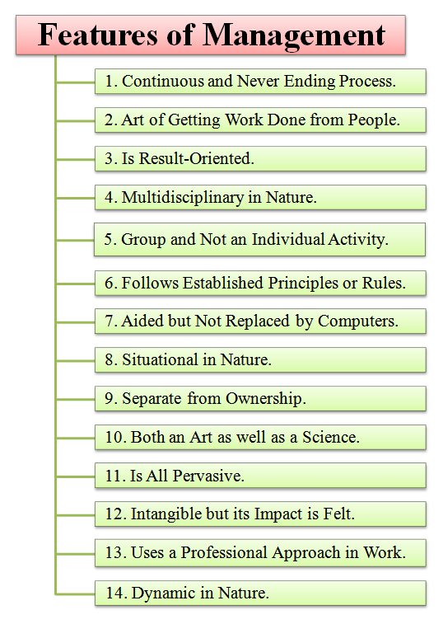

Slide 11
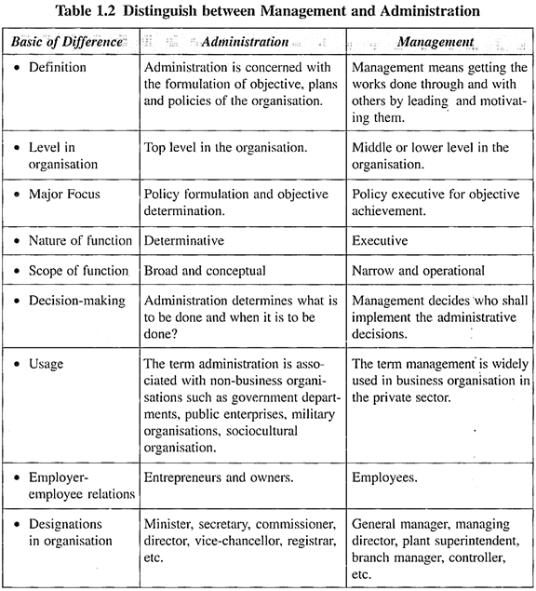

Slide 12
https://www.slideshare.net/sriprasadnavulla/introduction-to-management-44199900
https://www.slideshare.net/vishalarvindbhole/basic-concept-of-management-10794171
https://slideplayer.com/slide/5264707/

